Slide 1
Hijacking Bitcoin: Routing attacks on cryptocurrencies
Aviv Zohar
School Computer Science and Engineering
The Hebrew University of Jerusalem
Based on joint work with Maria Apostolaki and Laurent Vanbever

Slide 2
Cash
Digital Payments
Blue: 2
Red: 1
Bitcoin & similar currencies
Blue: 2
Red: 1
Blue: 2
Red: 1
Blue: 2
Red: 1
Blue: 2
Red: 1
Blue: 2
Red: 1
Blue: 2
Red: 1
Blue: 2
Red: 1
Blue: 2
Red: 1
Secured by “proof-of-work”
The Blockchain: A record of transactions
2

Slide 3
The Longest Chain Rule and Double-Spend Attacks
Bitcoin’s Guarantee [Satoshi]:
As long as
attacker controls < 50% of compute power, and
nodes can quickly broadcast blocks
The probability of block replacement decreases exponentially with time.

Slide 4
BGP and Routing
192.56.*.*
Via AS2,AS1
Routing table
192.56.*.* to AS1
192.56.*.*
Via AS1
AS3
AS2
AS4
I have IP range 192.56.*.*
AS8
AS5
AS1
AS6
AS7

Slide 5
BGP and Routing
AS3
AS2
AS4
AS8
AS5
AS1
AS6
AS7

Slide 6
Prefix Hijacking
AS3
AS2
Routing table
192.56.*.* to AS1
192.56.129.* to AS 5
AS4
I have IP range 192.56.129.*
I have IP range 192.56.*.*
AS8
AS5
AS1
Route by most specific prefix!
AS6
AS7

Slide 7
Prefix Hijacking
AS3
AS2
AS4
I have IP range 192.56.129.*
I have IP range 192.56.*.*
AS8
AS5
AS1
AS6
AS7

Slide 8
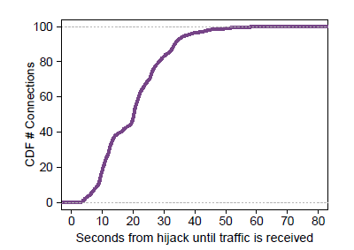
Hijacked our own node
Hijacks are fast.
Slow to repair
human intervention needed
takes hours

Slide 9
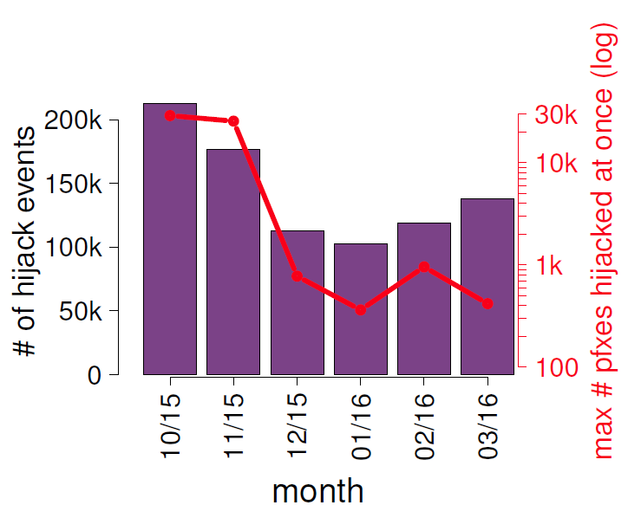
Hijacks are common

Slide 10
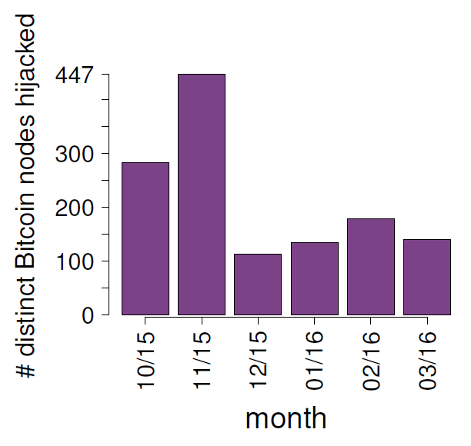

Slide 11
Consequences of disrupting connectivity
Transactions cannot be sent (DoS)
Pool rewards can be stolen
Transactions on one side of the network are reversed
Miners lose revenue
Double spending attacks against merchants
Mining power subverted to attack
double spend
selfish mining
Censorship via empty blocks

Slide 12
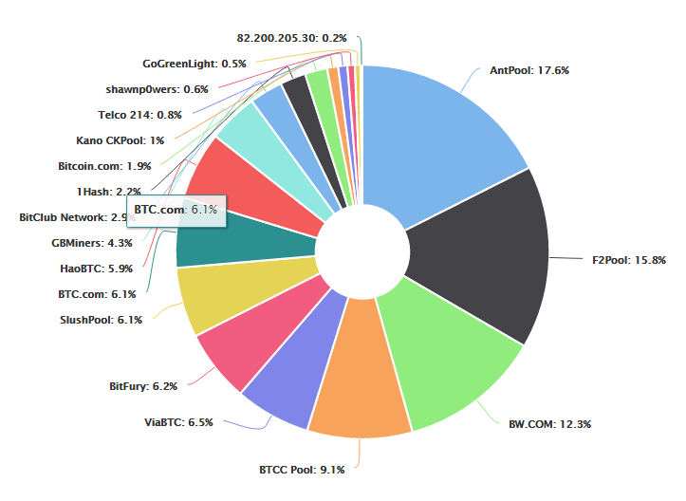
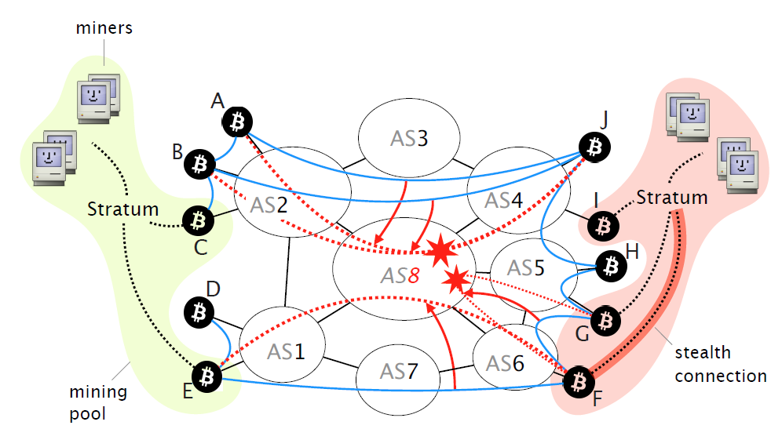
Mining pools

Slide 13
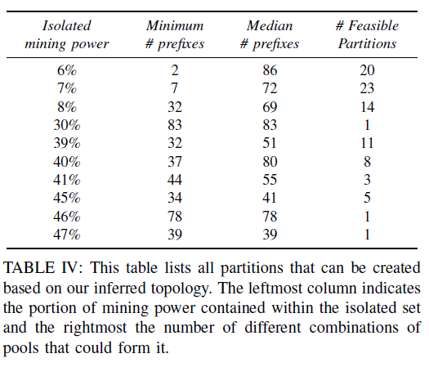
Attack 1: Partitioning Bitcoin
Deduce gateway nodes for pools
Stratum servers
Block propagation data
Combine with routing data
Factors that aid attacker:
Mining power is held by few nodes
Only 7% of nodes are advertised in /24 prefixes

Slide 14
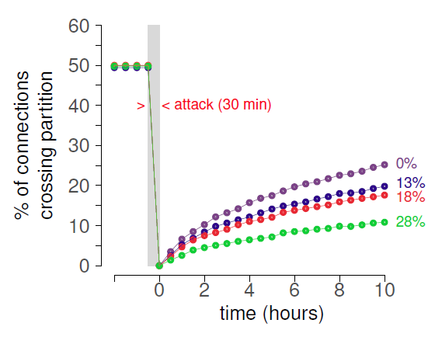
Partitions need to be perfect
1050 bitcoind nodes running on VMs on emulated network.
With churn (as measured on network)
Connections return slowly
BUT a few connections suffice.

Slide 15
Blocks Propagation Mechanics
sender
receiver
INV: Block 1dafe8b243ae
GETDATA:
Block 1dafe8b243ae
INV
INV
GETDATA
INV
Block transfer
Traffic is not encrypted!

Slide 16
Blocks Propagation Mechanics
sender
receiver
INV: Block 1dafe8b243ae
GETDATA:
Block 1dafe8b243ae
20 min
No block: Connection Drop

Slide 17
Attack 2a: MitM block delay attack
sender
MitM
receiver
MitM sees traffic TO reciever
INV: Block 1dafe8b243ae
GETDATA: Block 1dafe8b243ae
Block transfer
Invalid block
20 min
Connection Drop

Slide 18
Attack 2b: MitM block delay attack
sender
MitM
receiver
INV: Block 1dafe8b243ae
MitM sees traffic FROM reciever
GETDATA: Block 1dafe8b243ae
GETDATA: Block 2d31bacd451e1
19 min
GETDATA: Tx f311e5db78a2
GETDATA: Block 1dafe8b243ae
Connection not lost.
Repeat attack!
BLOCK transfer

Slide 19
We performed this MitM attack on our own node
Passive AS (no hijacking)
Uninformed node wastes mining power
Susceptible to 0-conf attacks

Slide 20
Other attacks on the P2P overlay
(another paper with Ethan Heilman, Sharon Goldberg, Allison Kendler)
Eclipse attack: Target P2P network formation
DNS
List of nodes
Known Peers
34.28.1.2
134.67.8.91
51.21.194.5
114.25.7.61
45.67.8.13
134.67.8.91
More nodes
134.17.8.91
51.22.194.5
112.25.7.61
35.28.1.2
Lists of attacker nodes

Slide 21
Summary
Bitcoin is considered secure as long as nodes can communicate
Communication is easily disrupted
Mitigation techniques in the papers
Much more needed!

Slide 22
Thank You!
email: avivz@cs.huji.ac.il

