Slide 1
including analysis and debugging
Cilk, Cilk++, Cilkview, and Cilkscreen, are trademarks of CILK ARTS.

Slide 2
MAJOR SECTIONS
Cilk++ Syntax and Concepts
Races and Race Detection
Scalability Analysis

Slide 3
The Cilk++ Tool Set
The Cilk++ language for shared-memory multiprocessing (i.e., multicore)
Parallel
And
Distributed systems,
Testing,
Analysis, and
Debugging
Cilk++ is not distributed
Cilkscreen race detector
Cilkview scalability analyzer
Cilkscreen race detector

Slide 4
MAJOR SECTIONS
Cilk++ Syntax and Concepts
Races and Race Detection
Scalability Analysis

Slide 5
C++ Syntax and Concepts
Concurrency Platforms
Fibonacci Program
Nested Parallelism
Loop Parallelism
Serial Semantics
Work-stealing Scheduler

Slide 6
Concurrency Platforms
Programming directly on processor cores is painful and error-prone.
A concurrency platform abstracts processor cores, handles synchronization and communication protocols, and performs load balancing.
Examples:
  Pthreads and WinAPI threads
  Threading Building Blocks (TBB)
  OpenMP
  Cilk++

Slide 7

Fibonacci Numbers
The Fibonacci numbers are the sequence ⟨0, 1, 1, 2, 3, 5, 8, 13, 21, 34, …⟩, where each number is the sum of the previous two.
Recurrence:
  F₀ = 0,
  F₁ = 1,
  F_{n} = F_{n–1} + F_{n–2} for n > 1.
The sequence is named after Leonardo di Pisa (1170–1250 a.d.), also known as Fibonacci, a contraction of filius Bonaccii —“son of Bonaccio.” Fibonacci’s 1202 book Liber Abaci introduced the sequence to Western mathematics, although it had previously been discovered by Indian mathematicians.

Slide 8

Fibonacci Program
#include <stdio.h>
#include <stdlib.h>
int fib(int n)
{
if (n < 2) return n;
else {
int x = fib(n-1);
int y = fib(n-2);
return x + y;
}
}
int main(int argc, char *argv[])
{
int n = atoi(argv[1]);
int result = fib(n);
printf("Fibonacci of %d is %d.\n", n, result);
return 0;
}
Disclaimer
This recursive program is a poor way to compute the nth Fibonacci number, but it provides a good didactic example.

Slide 9
Fibonacci Execution
fib(4)
fib(3)
fib(2)
fib(2)
fib(1)
fib(1)
fib(0)
fib(1)
fib(0)
int fib(int n)
{
if (n < 2) return n;
else {
int x = fib(n-1);
int y = fib(n-2);
return x + y;
}
}
Key idea for parallelization
The calculations of fib(n-1) and fib(n-2) can be executed simultaneously without mutual interference.

Slide 10
Cilk++
Small set of linguistic extensions to C++ to support fork-join parallelism.
Developed by CILK ARTS, an MIT spin-off.
Based on the award-winning Cilk multithreaded language developed at MIT.
Features a provably efficient work-stealing scheduler.
Provides a hyperobject library for parallelizing code with global variables.
Includes the Cilkscreen™ Race Detector and Cilkview™ Scalability Analyzer.

Slide 11
Serial Fibonacci Function in C++
int fib(int n)
{
if (n < 2) return n;
int x, y;
x = fib(n-1);
y = fib(n-2);
return x+y;
}

Slide 12
Nested Parallelism in Cilk++
The named child function may execute in parallel with the parent caller.
int fib(int n)
{
if (n < 2) return n;
int x, y;
x = cilk_spawn fib(n-1);
y = fib(n-2);
cilk_sync;
return x+y;
}
Control cannot pass this point until all spawned children have returned.
Cilk++ keywords grant permission for parallel execution. They do not command parallel execution.

Slide 13
Loop Parallelism in Cilk++
Example:
In-place matrix transpose
a₁₁
a₁₂
⋯
a_{1n}
a₁₁
a₂₁
⋯
a_{n1}
a₂₁
a₂₂
⋯
a_{2n}
a₁₂
a₂₂
⋯
a_{n2}
⋮
⋮
⋱
⋮
⋮
⋮
⋱
⋮
a_{n1}
a_{n2}
⋯
a_{nn}
a_{1n}
a_{2n}
⋯
a_{nn}
A
A^{T}
The iterations of a cilk_for loop execute in parallel.
// indices run from 0, not 1
cilk_for (int i=1; i<n; ++i) {
cilk_for (int j=0; j<i; ++j) {
double temp = A[i][j];
A[i][j] = A[j][i];
A[j][i] = temp;
}
}
The total number of iterations must be known at the start of the loop

Slide 14
Serial Semantics
int fib (int n) {
if (n<2) return (n);
else {
int x,y;
x = cilk_spawn fib(n-1);
y = fib(n-2);
cilk_sync;
return (x+y);
}
}
The C++ serialization of a Cilk++ program is always a legal interpretation of the program’s semantics.
Cilk++ source
Remember, Cilk++ keywords grant permission for parallel execution. They do not command parallel execution.
int fib (int n) {
if (n<2) return (n);
else {
int x,y;
x = fib(n-1);
y = fib(n-2);
return (x+y);
}
}
Serialization
#define cilk_for for
#define cilk_spawn
#define cilk_sync
To obtain the serialization:
Or, specify a switch to the Cilk++ compiler.

Slide 15
Scheduling
The Cilk++ concurrency platform allows the programmer to express potential parallelism in an application.
The Cilk++ scheduler maps the executing program onto the processor cores dynamically at runtime.
Cilk++’s work-stealing scheduler is provably efficient.
int fib (int n) {
if (n<2) return (n);
else {
int x,y;
x = cilk_spawn fib(n-1);
y = fib(n-2);
cilk_sync;
return (x+y);
}
}
Memory
I/O
Network
…
P
P
P
P
$
$
$

Slide 16


Cilk++ Platform
int fib (int n) {
if (n<2) return (n);
else {
int x,y;
x = cilk_spawn fib(n-1);
y = fib(n-2);
cilk_sync;
return (x+y);
}
}
3
Cilk++
Hyperobject
Library
2
Cilk++
Compiler
1
Conventional
Compiler
Cilk++ source
6
Cilkview
Scalability Analyzer
Linker
int fib (int n) {
if (n<2) return (n);
else {
int x,y;
x = fib(n-1);
y = fib(n-2);
return (x+y);
}
}
Binary
5
Cilkscreen
Race Detector
Serialization
4
Cilk++ Runtime
System
Conventional
Regression Tests
Parallel
Regression Tests
Reliable Single-Threaded Code
Exceptional Performance
Reliable Multi-Threaded Code

Slide 17
Cilk++ Summary
Cilk++ is a C++-based language for programming shared-memory multicore machines.
Cilk++ adds thee keywords to C++:
  cilk_spawn allows parallel execution of a subroutine call.
  Control cannot pass through a cilk_sync until all child functions have completed.
  cilk_for permits iterations of a loop to execute in parallel.
The Cilk++ toolset includes hyperobjects, Cilkscreen and Cilkview

Slide 18
MAJOR SECTIONS
Cilk++ Syntax and Concepts
Races and Race Detection
Scalability Analysis

Slide 19
Races and Race Detection
What are Race Bugs?
Avoiding Races
Hyperobjects (Overview only)
Cilkscreen Race Detector

Slide 20
Race Bugs
Definition. A determinacy race occurs when two logically parallel instructions access the same memory location and at least one of the instructions performs a write.
Example
A
int x = 0;
A
int x = 0;
cilk_for(int i=0, i<2, ++i) {
x++;
}
assert(x == 2);
x++;
x++;
B
C
B
C
D
assert(x == 2);
D
Dependency Graph

Slide 21
A Closer Look
1
x = 0;
A
int x = 0;
2
r1 = x;
4
r2 = x;
x++;
x++;
B
C
3
r1++;
5
r2++;
assert(x == 2);
7
x = r1;
6
x = r2;
D
8
assert(x == 2);
?
0
1
1
?
0
1
?
0
1
x
r1
r2

Slide 22
Types of Races
Suppose that instruction A and instruction B both access a location x, and suppose that A∥B (A is parallel to B).
A | B | Race Type
read | read | none
read | write | read race
write | read | read race
write | write | write race
Two sections of code are independent if they have no determinacy races between them.

Slide 23
Non-local Variables
1973 — Historical perspective
Wulf & Shaw: “We claim that the non-local variable is a major contributing factor in programs which are difficult to understand.”
2009 — Today’s reality
Non-local variables are used extensively, in part because they avoid parameter proliferation — long argument lists to functions for passing numerous, frequently used variables.
Global and other nonlocal variables can inhibit parallelism by inducing race bugs.

Slide 24
Reducer Hyperobjects
A variable x can be declared as a reducer over an associative operation, such as addition, multiplication, logical AND, list concatenation, etc.
Strands can update x as if it were an ordinary nonlocal variable, but x is, in fact, maintained as a collection of different views.
The Cilk++ runtime system coordinates the views and combines them when appropriate.
When only one view of x remains, the underlying value is stable and can be extracted.
x: 42
x: 14
x: 33
Example: summing reducer
89

Slide 25
Using Reducer Hyperobjects
#include <cilk.h>
#include <reducer_min.h>
template <typename T>
size_t IndexOfMin(T array[], size_t n) {
cilk::reducer_min_index<size_t, T> r;
cilk_for (int i = 0; i < n; ++i)
r.min_of(i, array[i]);
return r.get_index();
}
(TBB version on slide 41 of Arch’s talk)

Slide 26
Avoiding Races
Iterations of a cilk_for should be independent.
Between a cilk_spawn and the corresponding cilk_sync, the code of the spawned child should be independent of the code of the parent, including code executed by additional spawned or called children.
  Note: The arguments to a spawned function are evaluated in the parent before the spawn occurs.
Machine word size matters. Watch out for races in packed data structures:
struct{
char a;
char b;
} x;
Updating x.a and x.b in parallel may cause a race! Nasty, because it may depend on the compiler optimization level. (Safe on x86 and x86_64.)

Slide 27
Cilkscreen Race Detector
If an ostensibly deterministic Cilk++ program run on a given input could possibly behave any differently than its serialization, the race detector is guaranteed to report and localize at least two accesses participating in the race.
Employs a regression-test methodology, where the programmer provides test inputs.
Identifies filenames, lines, and variables involved in races, including stack traces.
Runs off the binary executable using dynamic instrumentation.
Runs about 20 times slower than real-time.

Slide 28
Cilk++ and Cilkscreen
In theory, a race detector could be constructed to find races in any multithreaded program
but…
Only a structured parallel programming environment with serial semantics like Cilk++ allows race detection with bounded memory and time overhead, independent of the number of threads.

Slide 29
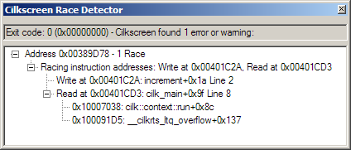
Cilkscreen Screen Shot
void increment(int& i) {
++i;
}
int cilk_main() {
int x = 0;
cilk_spawn increment(x);
int y = x - 1;
return 0;
}
Address of variable that was accessed in parallel
Location of “first” access
Location of “second” access
Stack trace of “second” access

Slide 30
Data Race Take-aways
A data race occurs when two parallel strands access the same memory location and at least one performs a write.
Access need not be simultaneous for the race to be harmful.
Cilkscreen is guaranteed to find data races if the occur in a program execution.
Non-local variables are the source of data races.
Cilk++ hyperobjects can be used to eliminate many data races.

Slide 31
MAJOR SECTIONS
Cilk++ Syntax and Concepts
Races and Race Detection
Scalability Analysis

Slide 32
Scalability Analysis
What Is Parallelism?
Scheduling Theory
Cilk++ Runtime System
A Chess Lesson

Slide 33

Amdahl’s Law
If 50% of your application is parallel and 50% is serial, you can’t get more than a factor of 2 speedup, no matter how many processors it runs on.*
*In general, if a fraction α of an application can be run in parallel and the rest must run serially, the speedup is at most 1/(1–α).
Gene M. Amdahl
But, whose application can be decomposed into just a serial part and a parallel part? For my application, what speedup should I expect?

Slide 34
Measurements Matter
Q: What does the performance of a program on 1 and 2 cores tell you about its expected performance on 16 or 64 cores?
A: Almost nothing
  Many parallel programs can’t exploit more than a few cores.
  To predict the scalability of a program to many cores, you need to know the amount of parallelism exposed by the code.
  Parallelism is not a “gut feel” metric, but a computable and measurable quantity.

Slide 35
Execution Model
int fib (int n) {
if (n<2) return (n);
else {
int x,y;
x = cilk_spawn fib(n-1);
y = fib(n-2);
cilk_sync;
return (x+y);
}
}
Example:
fib(4)
4
3
2
2
1
1
0
“Processor oblivious”
1
0
The computation dag unfolds dynamically.

Slide 36
Computation Dag
initial strand
final strand
strand
continue edge
return edge
spawn edge
call edge
A parallel instruction stream is a dag G = (V, E ).
Each vertex v ∈ V is a strand : a sequence of instructions not containing a call, spawn, sync, or return (or thrown exception).
An edge e ∈ E is a spawn, call, return, or continue edge.
Loop parallelism (cilk_for) is converted to spawns and syncs using recursive divide-and-conquer.

Slide 37
Performance Measures
T_{P} = execution time on P processors

Slide 38
Performance Measures
T_{P} = execution time on P processors
T₁ = work

Slide 39
Performance Measures
T_{P} = execution time on P processors
T₁ = work
T∞ = span*
* Also called critical-path length
or computational depth.

Slide 40
Performance Measures
T_{P} = execution time on P processors
T₁ = work
T∞ = span*
WORK LAW
  T_{P} ≥T₁/P
  SPAN LAW
  T_{P} ≥ T∞
* Also called critical-path length
or computational depth.

Slide 41
Series Composition
A
B
Work: T₁(A∪B) =
Work: T₁(A∪B) = T₁(A) + T₁(B)
Span: T∞(A∪B) = T∞(A) + T∞(B)
Span: T∞(A∪B) =

Slide 42
Parallel Composition
A
B
Work: T₁(A∪B) =
Work: T₁(A∪B) = T₁(A) + T₁(B)
Span: T∞(A∪B) = max{T∞(A), T∞(B)}
Span: T∞(A∪B) =

Slide 43
Speedup
Def. T₁/T_{P} = speedup on P processors.
If T₁/T_{P} = Θ(P), we have linear speedup,
= P, we have perfect linear speedup,
> P, we have superlinear speedup,
which is not possible in this performance model, because of the Work Law T_{P} ≥ T₁/P.

Slide 44
Parallelism
Because the Span Law dictates that T_{P} ≥ T∞, the maximum possible speedup given T₁ and T∞ is
T₁/T∞ = parallelism
= the average
amount of work
per step along
the span.

Slide 45
Provably Good Scheduling
Theorem. Cilk++’s randomized work-stealing scheduler achieves expected time
T_{P} ≤ T₁/P + O(T∞). ■
Corollary. Near-perfect linear speedup when
T₁/T∞ ≫ P,
i.e., ample parallel slackness.
Proof. Since T₁/T∞ ≫ P is equivalent to T∞ ≪ T₁/P, we have
T_{P} ≤ T₁/P + O(T∞)
≈ T₁/P .
Thus, the speedup is T₁/T_{P} ≈ P. ■

Slide 46
Example: fib(4)
1
8
Assume for simplicity that each strand in fib(4) takes unit time to execute.
2
7
3
4
6
5
Work: T₁ = 17
Work: T₁ =
Span: T∞ = 8
Span: T∞ =
Parallelism: T₁/T∞ =
Parallelism: T₁/T∞ = 2.125
Using many more than 2 processors can yield only marginal performance gains.

Slide 47
Cilk Chess Programs
Socrates placed 3rd in the 1994 International Computer Chess Championship running on NCSA’s 512-node Connection Machine CM5.
Socrates 2.0 took 2nd place in the 1995 World Computer Chess Championship running on Sandia National Labs’ 1824-node Intel Paragon.
Cilkchess placed 1st in the 1996 Dutch Open running on a 12-processor Sun Enterprise 5000. It placed 2nd in 1997 and 1998 running on Boston University’s 64-processor SGI Origin 2000.
Cilkchess tied for 3rd in the 1999 WCCC running on NASA’s 256-node SGI Origin 2000.

Slide 48
Developing Socrates
For the competition, Socrates was to run on a 512-processor Connection Machine Model CM5 supercomputer at the University of Illinois.
The developers had easy access to a similar 32-processor CM5 at MIT.
One of the developers proposed a change to the program that produced a speedup of over 20% on the MIT machine.
After a back-of-the-envelope calculation, the proposed “improvement” was rejected!

Slide 49
Socrates Paradox
Original program
Proposed program
T₃₂ = 65 seconds
T′₃₂ = 40 seconds
T_{P} ≈ T₁/P + T∞
T₁ = 2048 seconds
T′₁ = 1024 seconds
T ∞ = 1 second
T′∞ = 8 seconds
T₃₂ = 2048/32 + 1
T′₃₂ = 1024/32 + 8
= 65 seconds
= 40 seconds
T₅₁₂ = 2048/512 + 1
T′₅₁₂ = 1024/512 + 8
= 5 seconds
= 10 seconds

Slide 50
Moral of the Story
Work and span predict performance better than running times alone can.

Slide 51
Cilkview Scalability Analyzer
The Cilk environment provides a scalability analyzer, called Cilkview.
Like the race detector, Cilkview uses dynamic instrumentation.
Cilkview computes work and span to compute upper bounds on parallel performance.
Cilkview also estimates scheduling overhead to compute a burdened span for lower bounds.

Slide 52
Cilk++ and Cilkview
The cilk_spawn, cilk_sync, and cilk_for features of the Cilk++ language are composable so that one can reason about a piece of a program without following every spawn down to its leaves.
Composability dramatically simplifies the task of writing correct parallel programs.
Composability (and serial semantics) also allows Cilkview to meaningfully analyze a program as a whole or in parts.

Slide 53
Quicksort Analysis
Recall: Parallel quicksort
template <typename T>
void qsort(T begin, T end) {
if (begin != end) {
T middle = partition(
begin,
end,
bind2nd( less<typename iterator_traits<T>::value_type>(),
*begin )
);
cilk_spawn qsort(begin, middle);
qsort(max(begin + 1, middle), end);
cilk_sync;
}
}
Analyze the sorting of 100,000,000 numbers. ⋆⋆⋆ Guess the parallelism! ⋆⋆⋆

Slide 54
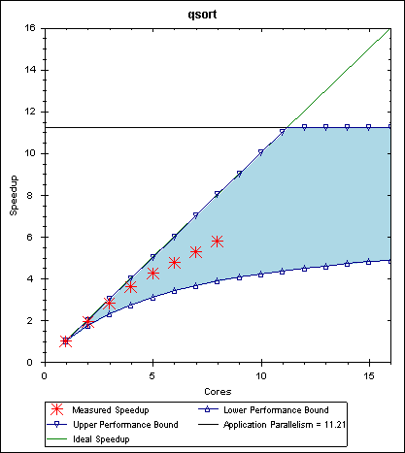
Cilkview Output
Span Law
Work Law
(linear speedup)
Measured speedup
Burdened span — estimates scheduling overheads
Parallelism

Slide 55
Work/Span Take-aways
Work (T₁) is the time needed execute a program on a single core.
Span (T∞) is the longest serial path through the execution DAG.
Parallelism is the ability of a program to use multiple cores and is computed as the ratio of work to span (T₁/T∞).
Speedup on P processors is computed as T₁/T_{P}. If speedup = P we have perfect linear speedup.
Cilkview measures work and span and can predict speedup for any P.

Slide 56
Lab summaries
Cilk, Cilk++, Cilkview, and Cilkscreen, are trademarks of CILK ARTS.

Slide 57
Lab 1: Getting started with Cilk++
In the lab we will:
Install Cilk++
Compile and run a sample program
Add Cilk++ keywords to the sample program
Run the cilkscreen race detector
Run the cilkview performance analyzer

Slide 58
Hints and Caveats
Work in pairs
Turn off CPU throttling
In Visual Studio, cilkscreen is available in the Tools menu.
Error in startup guide:
“-w” option should be “-workers”

Slide 59
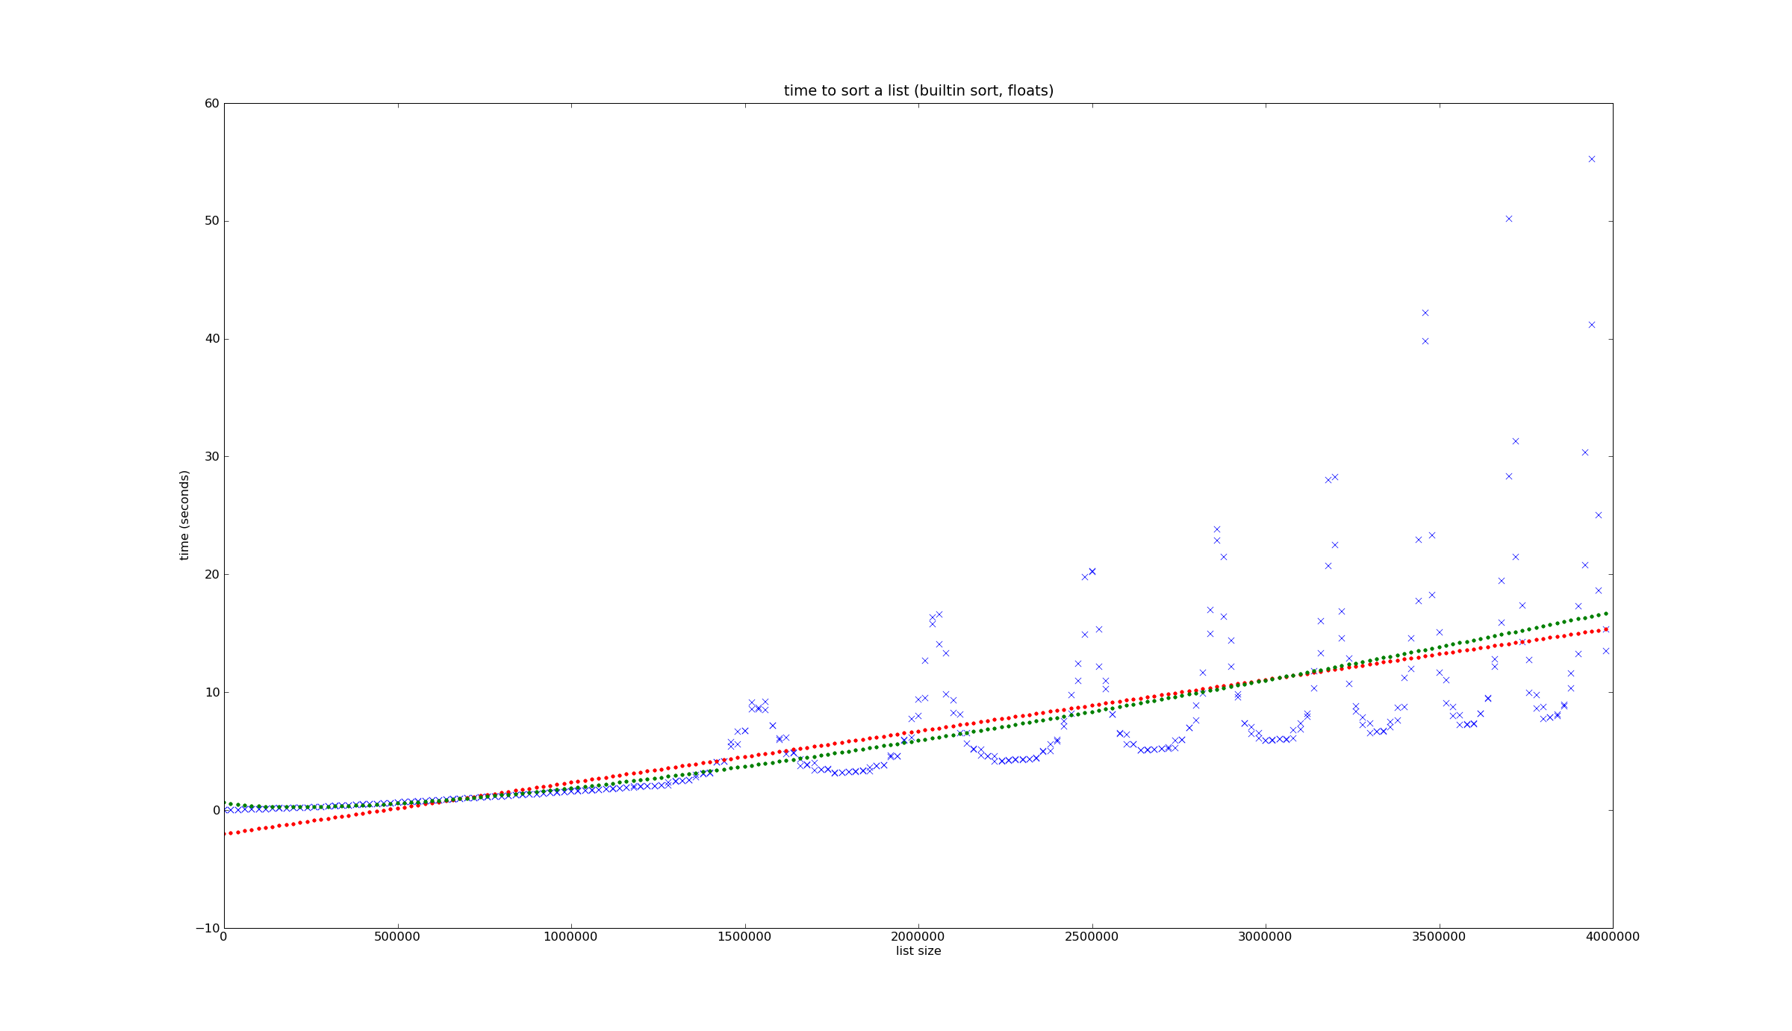
The CPU Clock
What your motherboard didn’t tell you
Courtesy Sivan Toledo, Tel Aviv University

Slide 60
Lab 2: Matrix Multiplication
In this lab we will
Parallelize matrix multiplication using parallel loops
Parallelize matrix multiplication using divide-and-conquer recursion
Explore cache locality issues
Try to write the fastest matrix multiply program that we can

